Slide 1



SALARY SURVEY REPORT
AKILAN J
DADS
30/01/2025

Slide 2



Slide 3
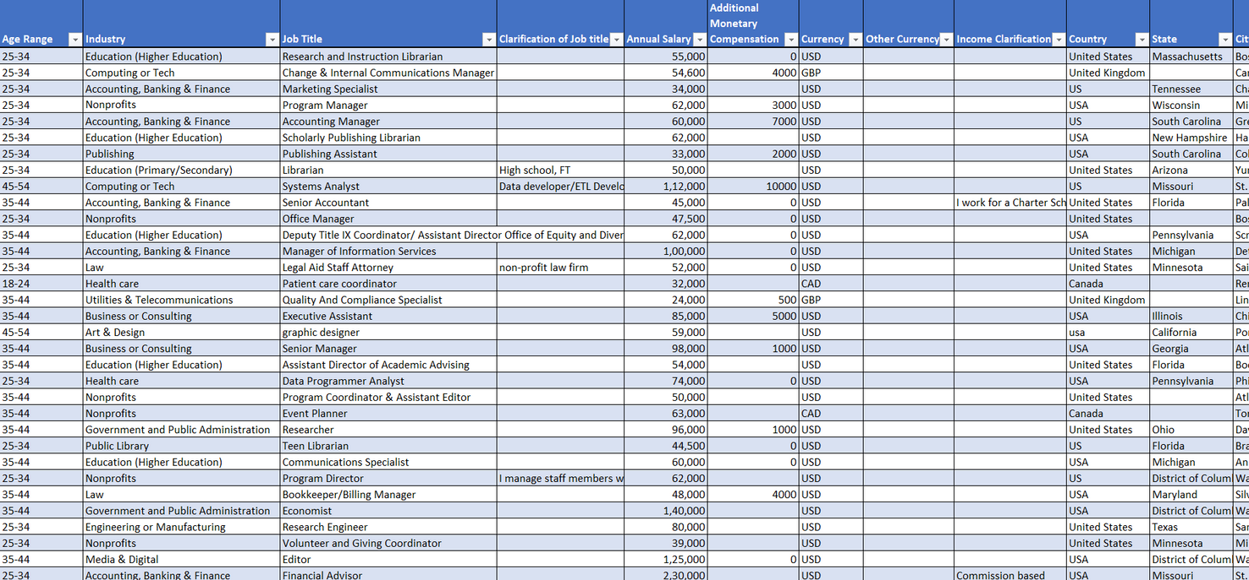
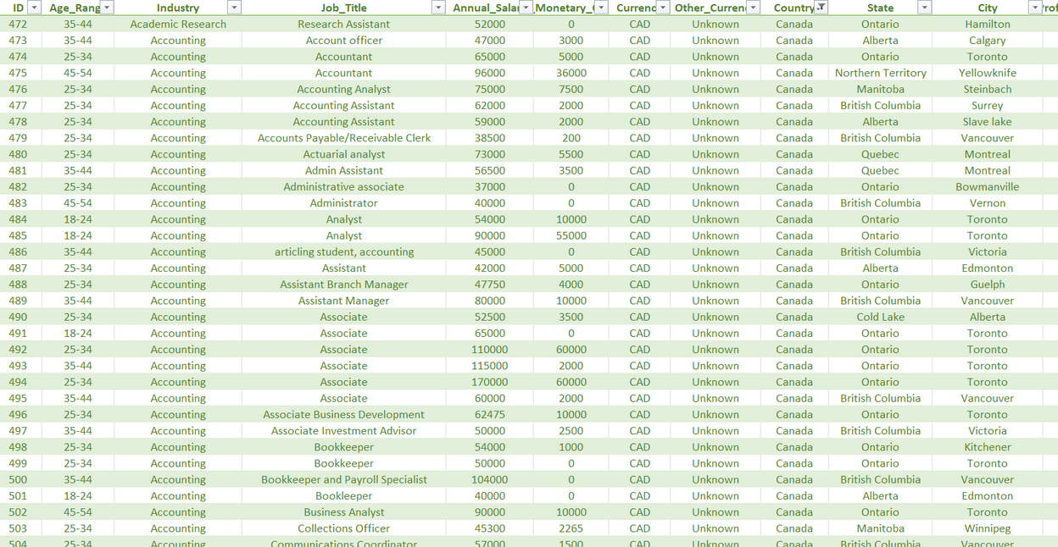
Data Cleaning and Preprocessing
RAW DATA
CLEANED DATA
28100 ROWS
27900 ROWS

Slide 4
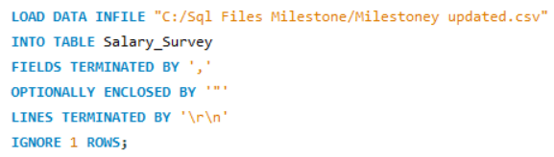
DATA IMPORT INTO SQL

Slide 5
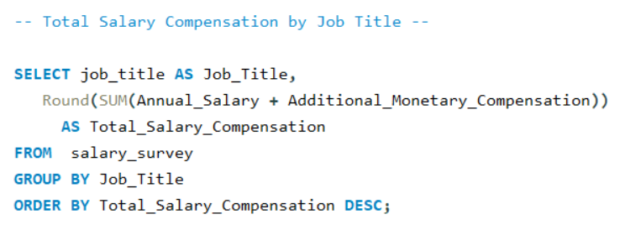
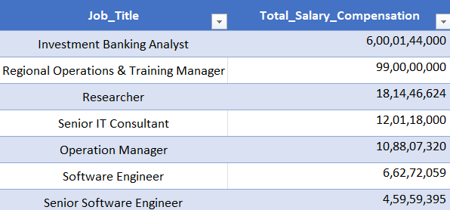
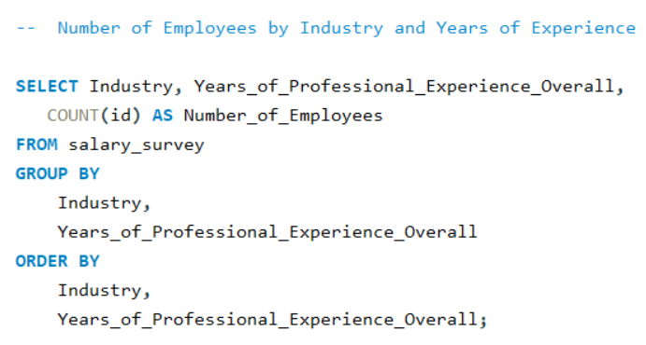
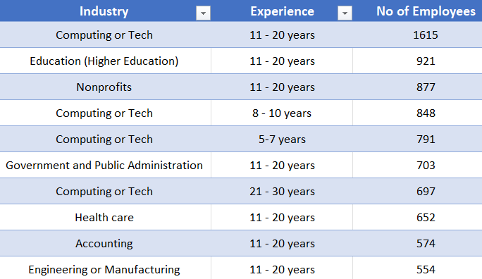
SQL QUERIES

Slide 6
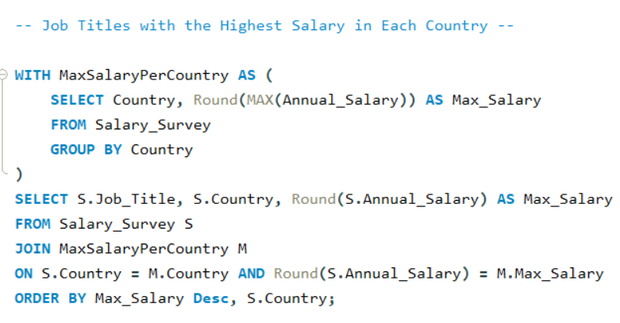
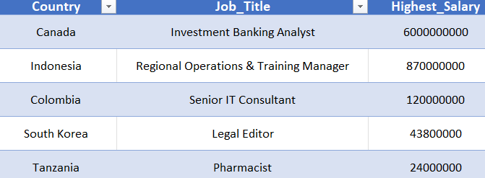
JOB ROLES WITH HIGHER PAY
REGARDING COUNTRY

Slide 7
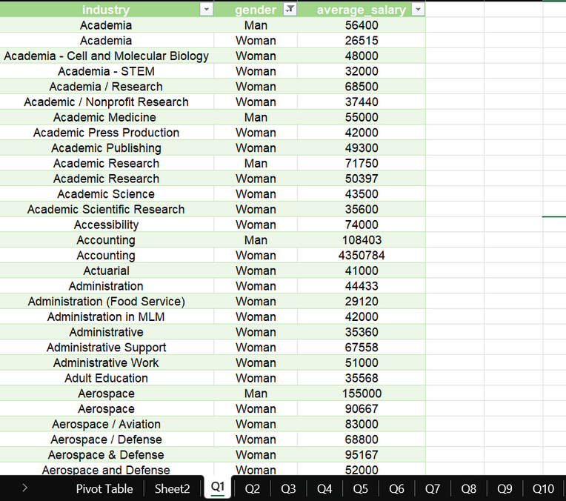
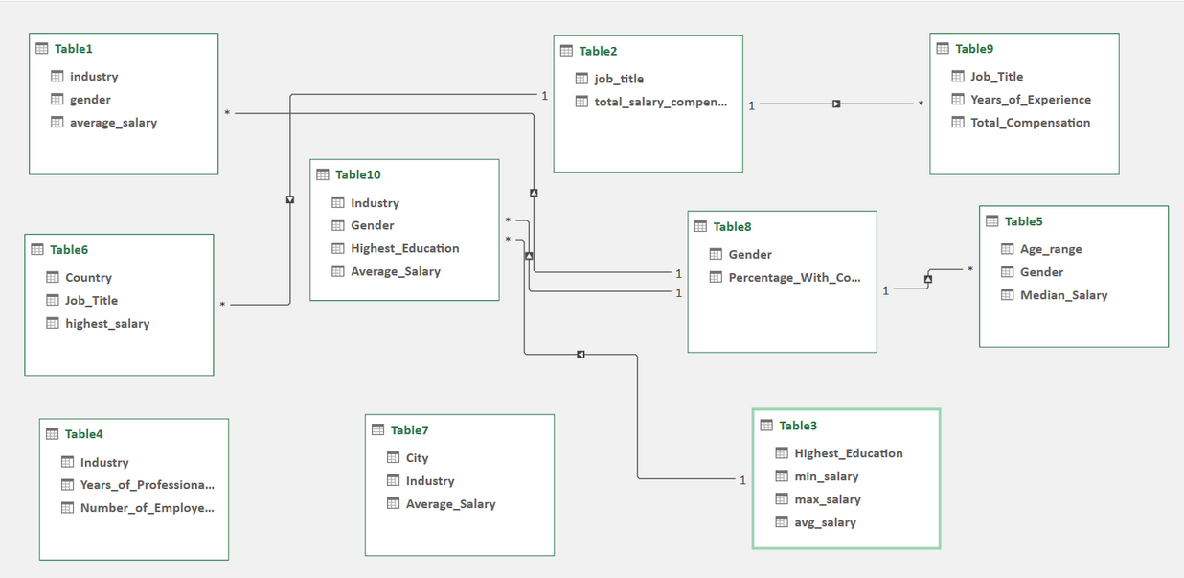
DATA EXPORT / TABLE RELATIONSHIP

Slide 8
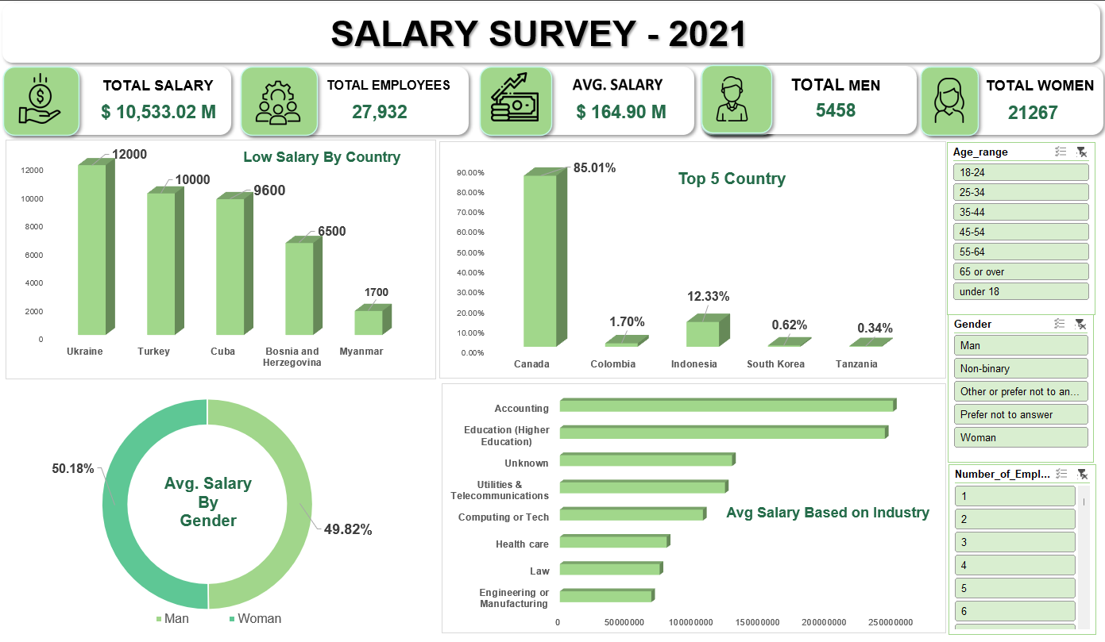

Slide 9
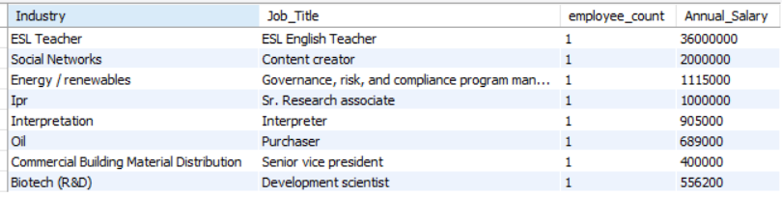
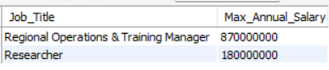
INSIGHT’S
Area of Focus
STUDENTS ,
CAREER PATH
COUNTRY - INDONESIA

Slide 10
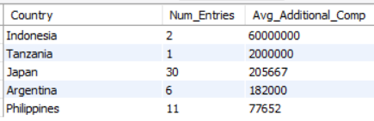
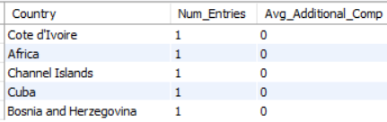
Additional Compensation
TOP COUNTRY
LEAST PAY

Slide 11




THANK YOU :)

